Slide 1
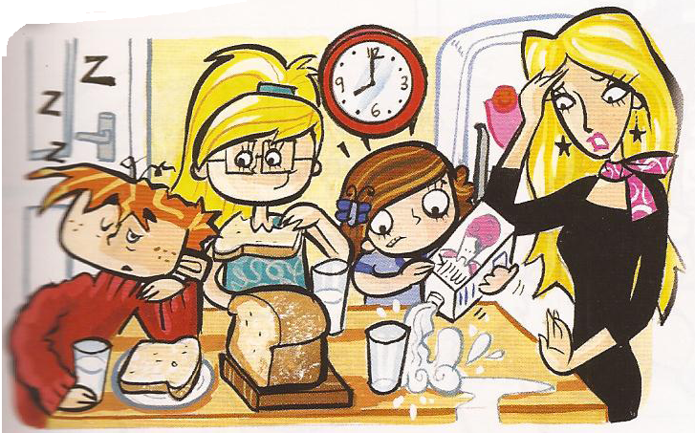
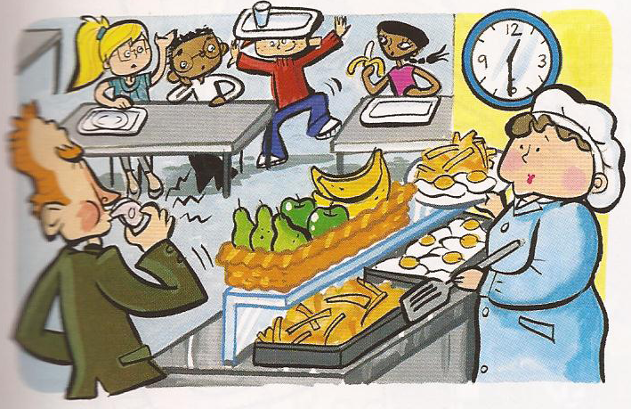
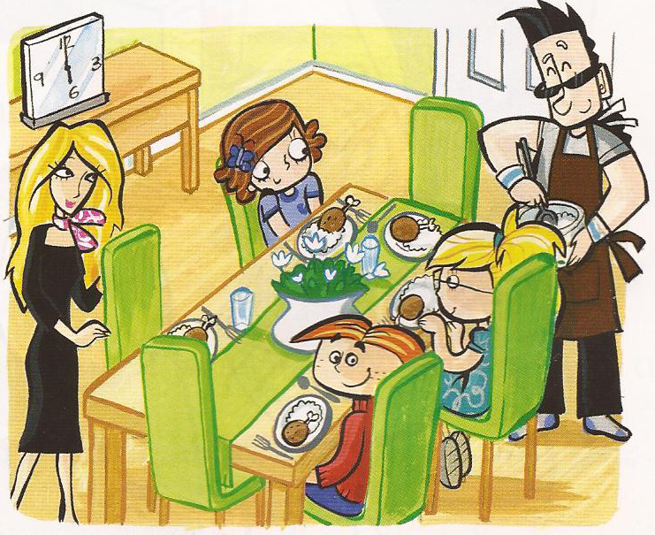
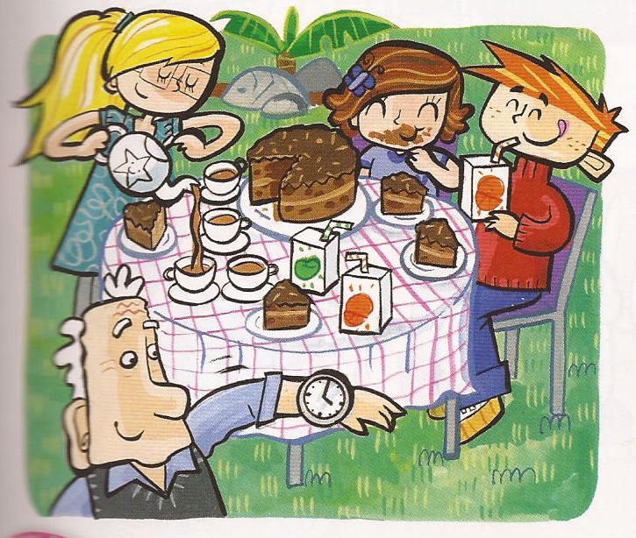
Time and Meals

Slide 2
Morning
Breakfast
Milk and bread
Notes:
Morning

Slide 3
Lunchtime
Lunch
Egg and chips
Notes:
Morning

Slide 4
Afternoon
Tea
Cake and tea
Notes:
Morning

Slide 5
Evening
Dinner
Chicken and rice
Notes:
Morning

Slide 6
Morning
Lunchtime
Breakfast
Lunch
Evening
Afternoon
Dinner
Tea

Slide 7
Morning
Lunchtime
Breakfast
Lunch
Evening
Afternoon
Dinner
Tea

