Slide 1
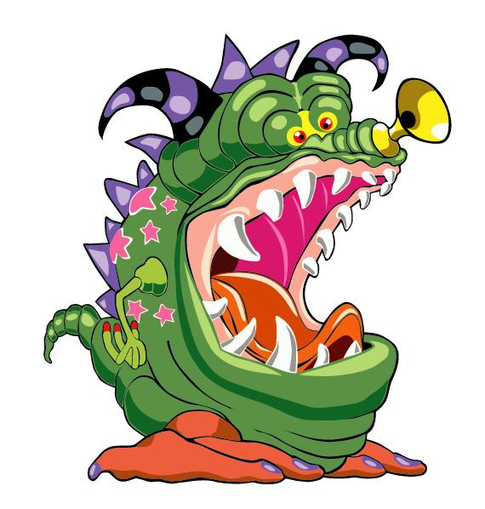
The Monster Song

Slide 2
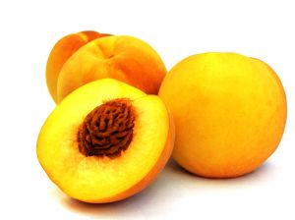
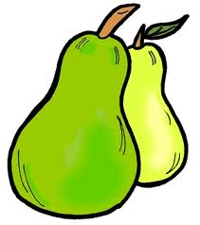
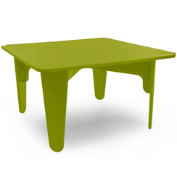
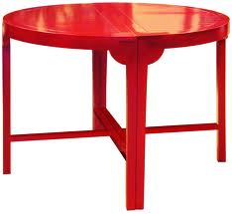
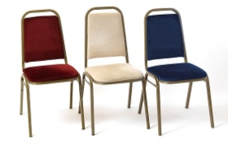
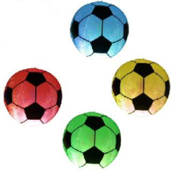
On Mondays I eat peaches.
On Tuesdays I eat pears.
On Wednesdays I eat tables.
On Thursdays I eat chairs.
On Fridays I eat footballs – four.
On Saturdays I eat three more.
On Sundays I can’t eat a thing.
I’m full so I just sit and sing.
Notes:
On Mondays I eat peaches.
On Tuesdays I eat pears.
On Wednesdays I eat tables.
On Thursdays I eat chairs.
On Fridays I eat footballs – four.
On Saturdays I eat three more.
On Sundays I can’t eat a thing.
I’m full so I just sit and sing.

Slide 3
On Mondays I eat peaches.
On Tuesdays I eat pears.
On Wednesdays I eat tables.
On Thursdays I eat chairs.
On Fridays I eat footballs – four.
On Saturdays I eat three more.
On Sundays I can’t eat a thing.
I’m full so I just sit and sing.
Notes:
On Mondays I eat peaches.
On Tuesdays I eat pears.
On Wednesdays I eat tables.
On Thursdays I eat chairs.
On Fridays I eat footballs – four.
On Saturdays I eat three more.
On Sundays I can’t eat a thing.
I’m full so I just sit and sing.

Slide 4
