Slide 1
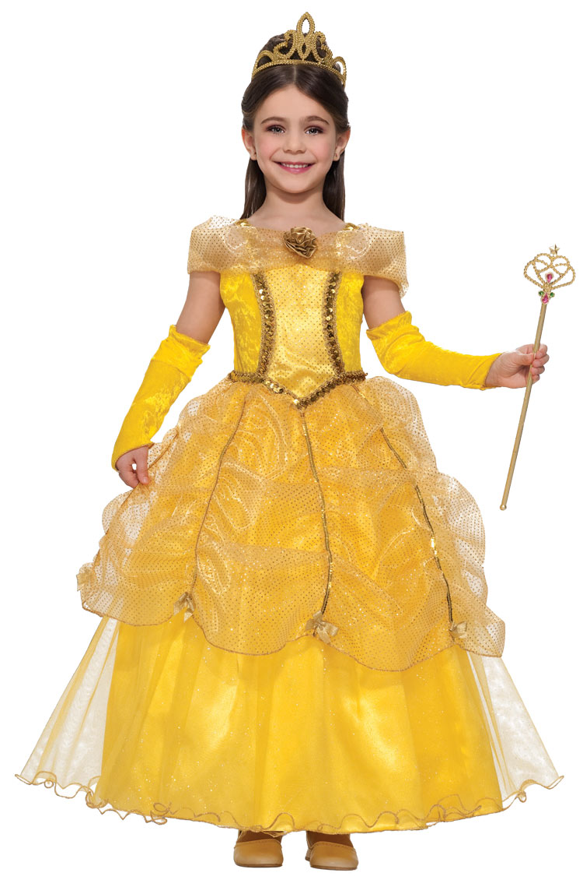
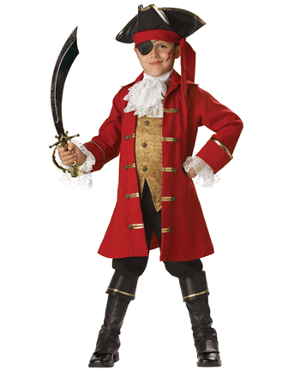
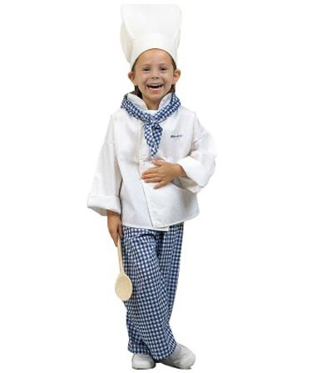
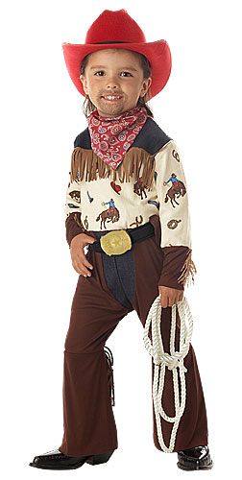
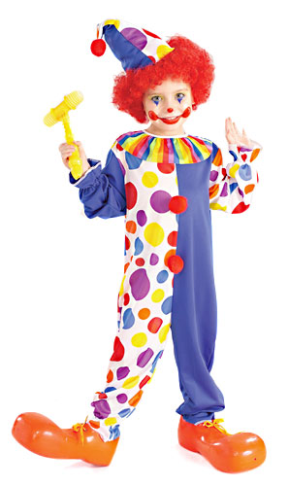
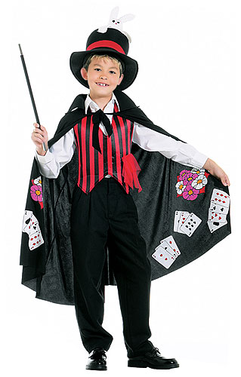
The fancy-dress party

Slide 2
The pirate
Notes:
He’s a pirate.

Slide 3
The clown

Slide 4
The cowboy

Slide 5
The cook

Slide 6
The princess

Slide 7
The magician

Slide 8
The princess
The pirate
The cook
The cowboy
The clown
The magician

Slide 9
The princess
The pirate
The cook
The cowboy
The clown
The magician

