Slide 1
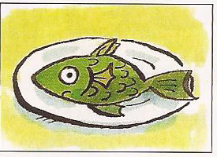
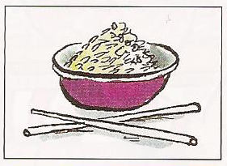
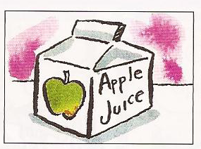
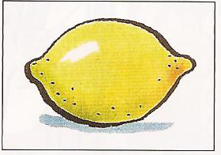
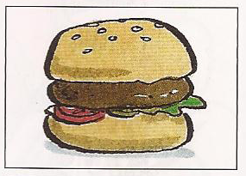
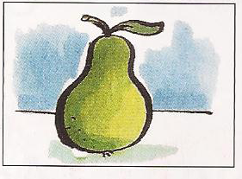
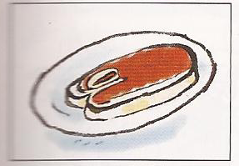
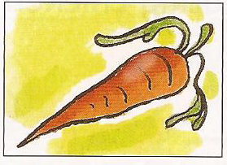
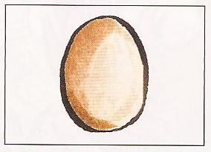
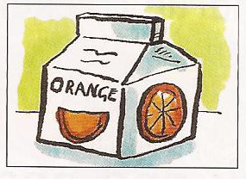
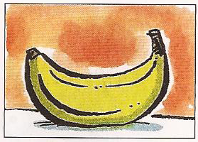
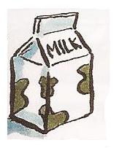
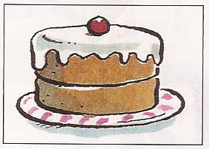
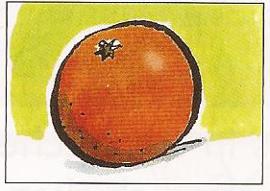
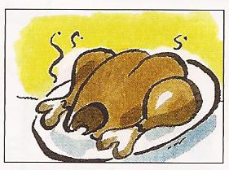
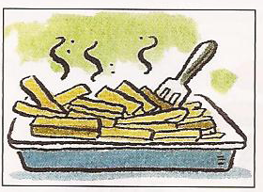
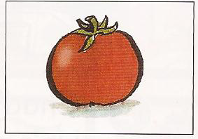
Food and
drink

Slide 2
fruit

Slide 3
apple

Slide 4
banana

Slide 5
lemon

Slide 6
orange

Slide 7
pear

Slide 8
tomato

Slide 9
carrot

Slide 10
potato

Slide 11
chips

Slide 12
rice

Slide 13
meat

Slide 14
chicken

Slide 15
fish

Slide 16
burger

Slide 17
bread

Slide 18
egg

Slide 19
cake

Slide 20
ice cream

Slide 21
apple juice

Slide 22
orange juice

Slide 23
milk

Slide 24
water

Slide 25
tea

Slide 26
rice
apple juice
apple
lemon
fish
potato
pear
carrot
burger
ice cream
meat
tea
bread
orange juice
egg
water
banana
milk
orange
tomato
cake
chicken
chips
Notes:
apple

Slide 27
rice
apple juice
apple
lemon
fish
potato
pear
carrot
burger
ice cream
meat
tea
bread
orange juice
egg
water
banana
milk
orange
tomato
cake
chicken
chips
Notes:
apple

