Slide 1
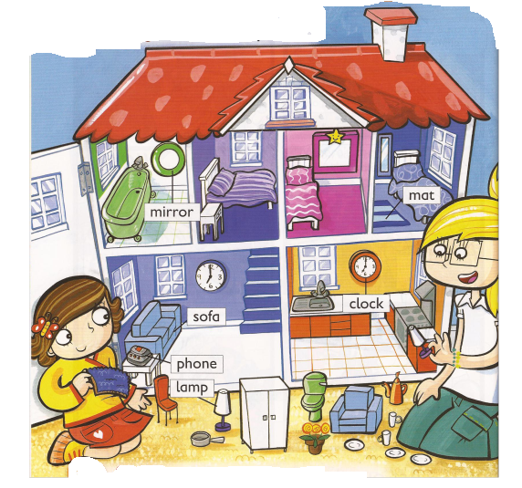
At home

Slide 2
Clock

Slide 3
Lamp

Slide 4
Mat

Slide 5
Mirror

Slide 6
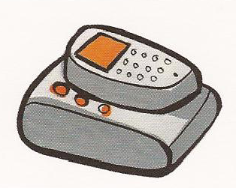
Phone

Slide 7
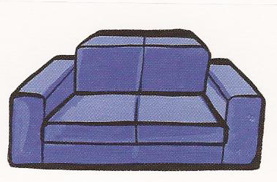
Sofa

Slide 8
Bed

Slide 9
Armchair

Slide 10
Bath

Slide 11
sofa
clock
mat
phone
armchair
bath
mirror
lamp
bed

Slide 12
sofa
clock
mat
phone
armchair
bath
mirror
lamp
bed

