Slide 1
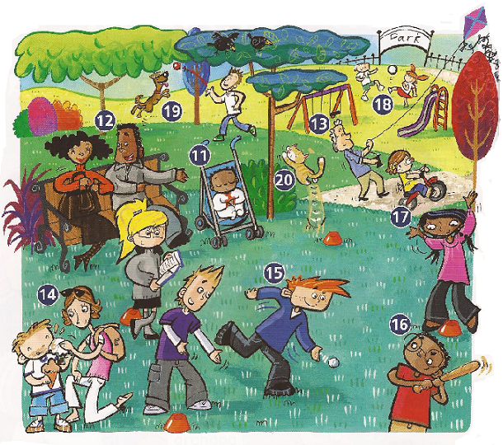
get
kick
fly
talk
sleep
jump
clean
catch
throw
hit

Slide 2
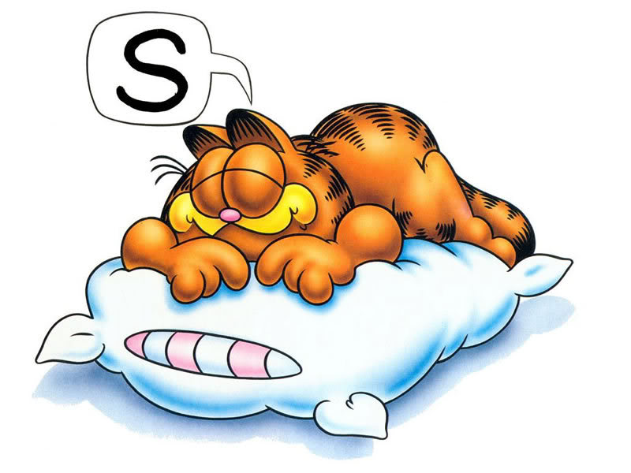
Sleep

Slide 3
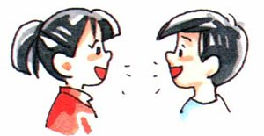
Talk

Slide 4
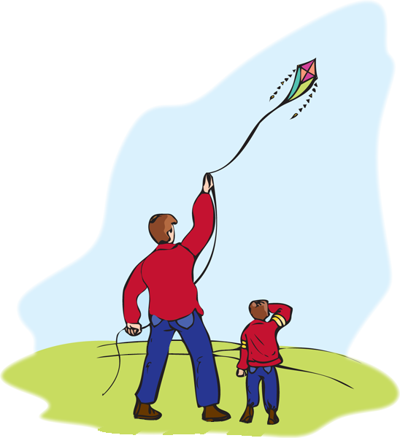
Fly a kite

Slide 5
Clean

Slide 6
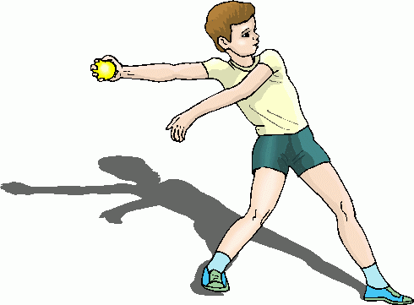
Sleep

Slide 7
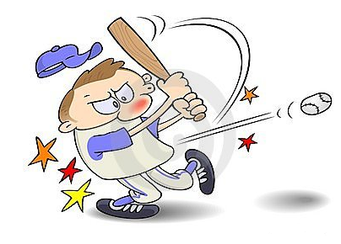
Hit

Slide 8
Catch

Slide 9
Kick

Slide 10
Get

Slide 11
Jump

Slide 12
Sit

Slide 13
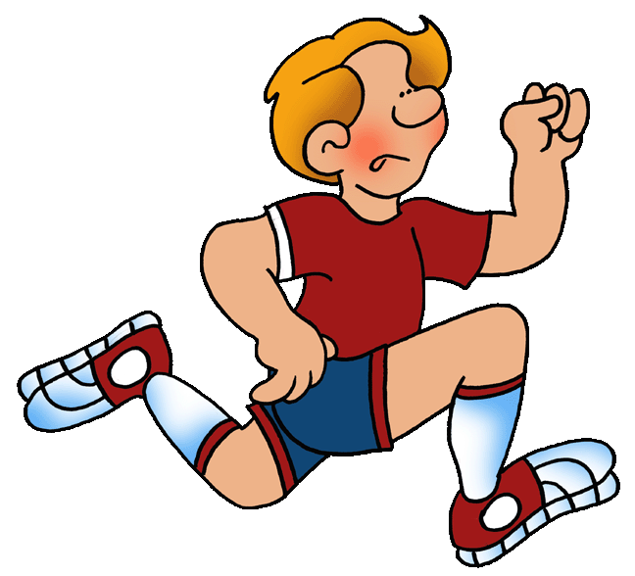
Run

Slide 14
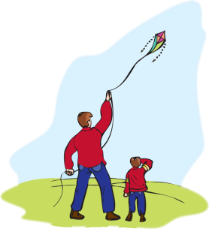
talk
jump
hit
throw
run
catch
kick
clean
sit
sleep
Fly a kite
get

Slide 15
talk
jump
hit
throw
run
catch
kick
clean
sit
sleep
Fly a kite
get

