Slide 1
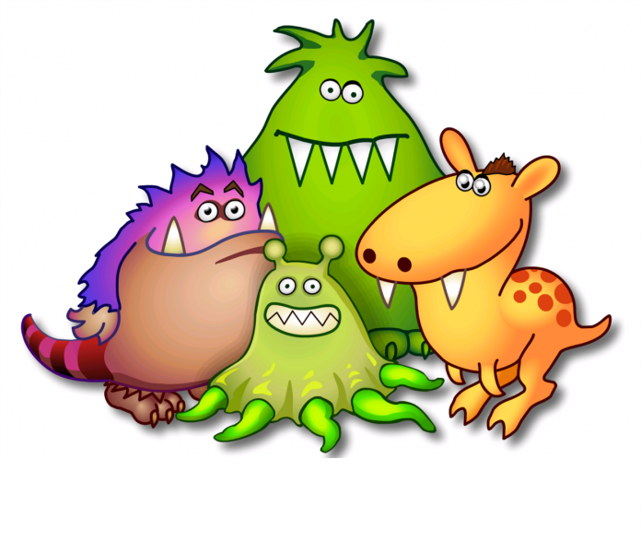
Past Simple
Were
Was
Yesterday
Last year
Two days ago

Slide 2
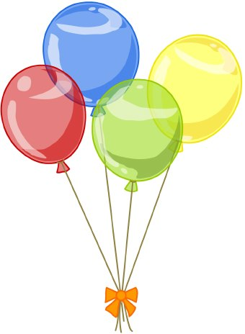
He
It
We
You
They
I
She
Was
Were

Slide 3
Today
Yesterday
I HE SHE IT | AM IS | WAS
WE YOU THEY | ARE | WERE
Notes:
Today

Slide 4
Today
Yesterday
I HE SHE IT | Am not Is not | Was not Wasn’t
WE YOU THEY | Are not | Were not Weren’t
Notes:
Today

Slide 5
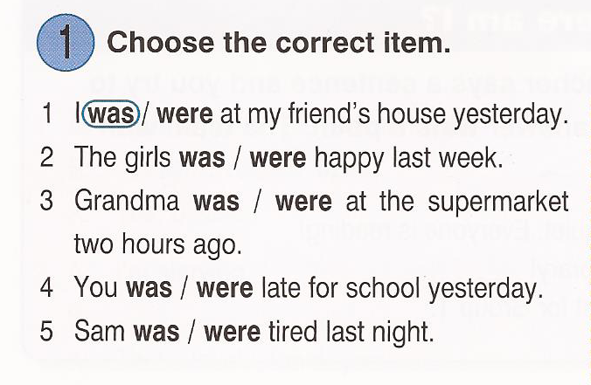

Slide 6
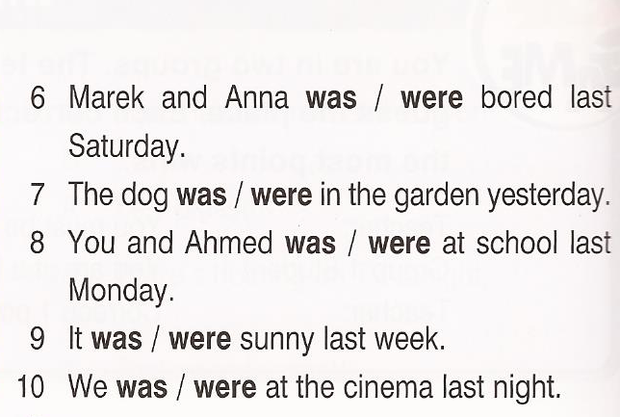

Slide 7
Today
Ex. 2 p. 85
Yesterday
1. They are at the cinema.
1. They were at the cinema.
2. I’m not happy.
2. I was not happy.
3. The film is scary.
3. The film was scary.
4. Is he in London?
4. Was he in London?
5. What is for lunch?
5. What was for lunch?
6. George isn’t very friendly.
6. George wasn’t very friendly.
7. Are they happy?
7. Were they happy?
8. It’s very hot.
8. It was very hot.

Slide 8
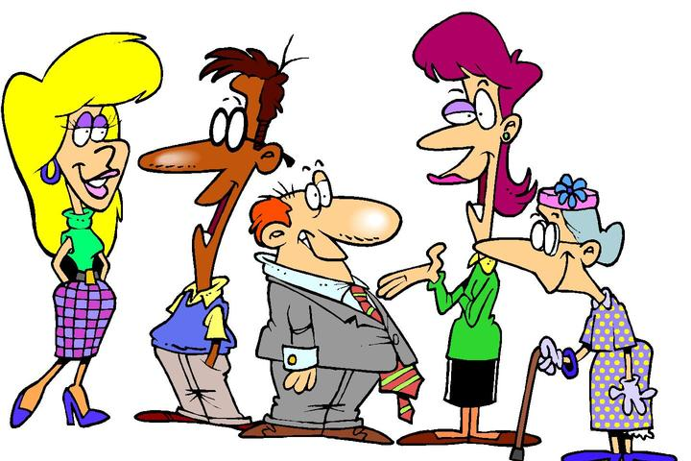
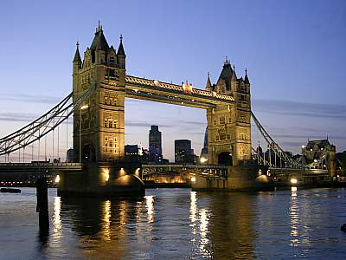
3
2. (the people / kind )
Were the people kind?
Yes, they were.

Slide 9
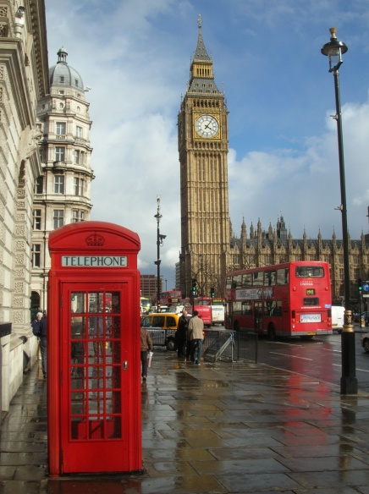
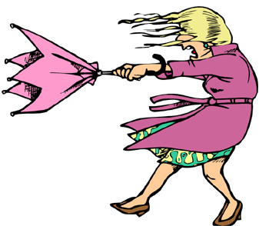
3
3. (the weather / good)
Was the weather good?
No, it wasn’t.

Slide 10
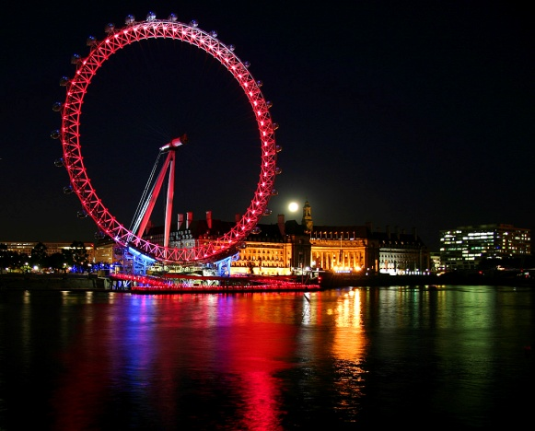
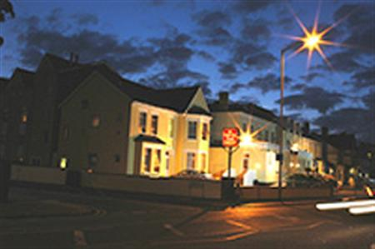
3
4. (the hotel / nice )
Was the hotel nice?
No, it wasn’t.

Slide 11
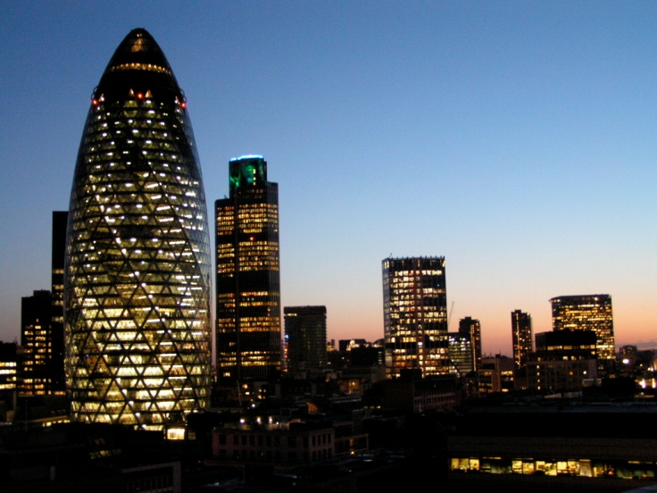
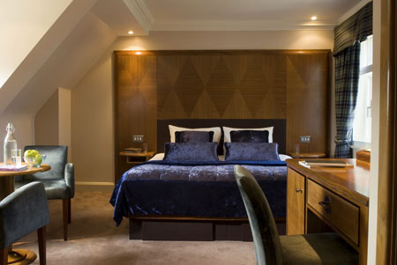
3
5. (Your room / small )
Was your room small?
Yes, it was.

Slide 12
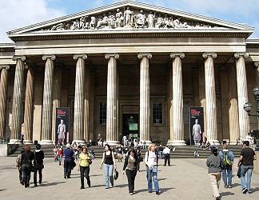
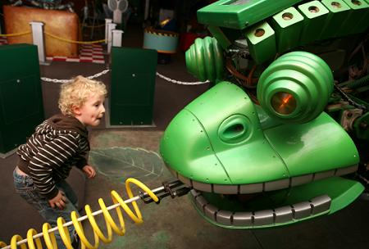
3
6. (the museums / interesting )
Were the museums interesting?
Yes, they were.

